Slide 1

CSC 203 / CPE 203
Week 5
Project-Based Object-Oriented
Programming and Design
(using Java)
Bill Foote
wffoote@calpoly.edu
(http://jovial.com)
Notes:
M: 1-14
T:; 1-22
W: To, or through python vars
R: UP to javadocs @ end
F: through 49

Slide 2
Total repositories: 81
Total graded: 69
Number of programs that compiled: 60
Of those:
average method similarity: 94%
average run score: 91%

Slide 3
Open / Closed Principle
“Software entities (classes, modules, functions, etc.) should be open for extension, but closed for modification”
  It should be possible to use your (library) code without modifying the source
Are you tempted to modify the source code of java.util.ArrayList.sort()?

Slide 4
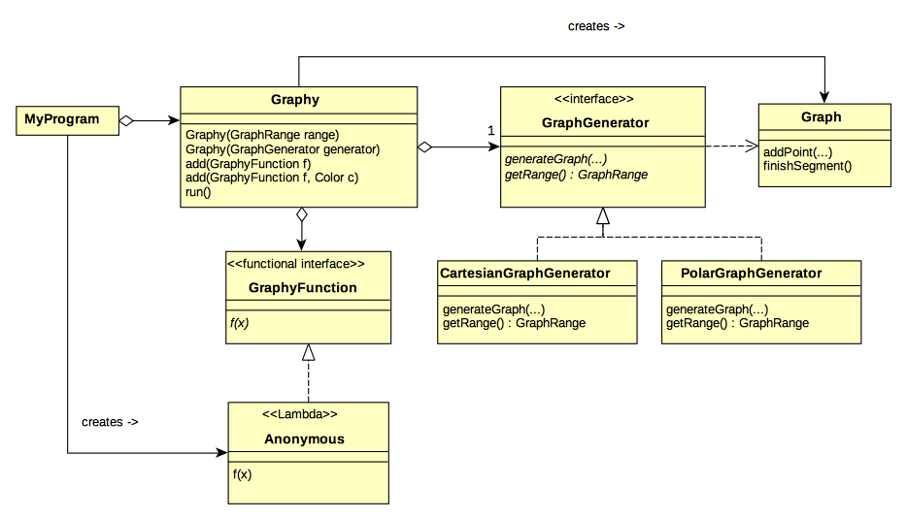

Slide 5
Open!

Slide 6
And now, for something completely different...

Slide 7
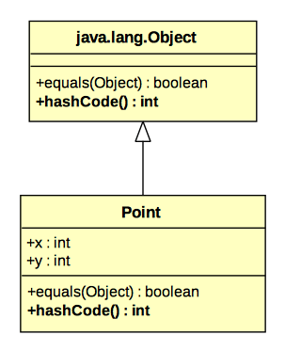

Slide 8
HashMap<String, Point>
Entry[hashCode]
1
2
“foo”
“bar”
3
4
HashMap<String, Point> map
= new HashMap<String, Point>();
map.add(“foo”, new Point(1, 2));
map.add(“bar”, new Point(3, 4));
Map.add(“baz”, new Point(9, 9));
map.add(“baz”, new Point(5, 6));
“baz”
5
6

Slide 9
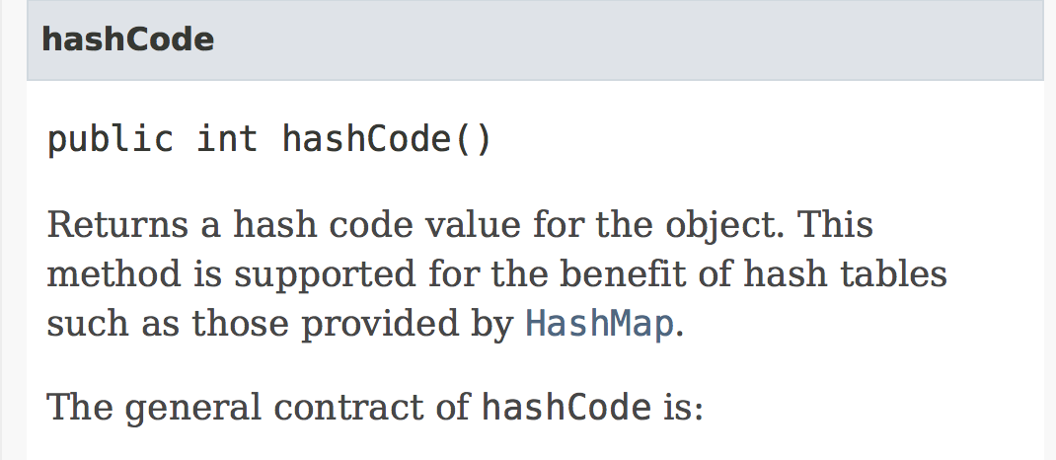
https://docs.oracle.com/javase/8/docs/api/java/lang/Object.html#hashCode--

Slide 10
HashMap<Point, ...>
public final class Point {
final int x, y;
…
public boolean equals(Object other) { … }
public int hashCode() {
return 42;
}
}

Slide 11
HashMap<Point, ...>
public final class Point {
final int x, y;
…
public boolean equals(Object other) { … }
public int hashCode() {
return x+y;
}
}

Slide 12
HashMap<Point, ...>
public final class Point {
final int x, y;
…
public boolean equals(Object other) { … }
public int hashCode() {
return x*97 + y;
}
}

Slide 13
HashMap<Point, ...>
public final class Point {
final int x, y;
…
public boolean equals(Object other) { … }
public int hashCode() {
return java.util.Objects.hash(x, y);
}
}

Slide 14
HashMap<MyList, ...>
public final class MyList {
int[] values;
…
public boolean equals(Object other) { … }
public int hashCode() {
int result = 0;
for (int i = 0; i < values.length; i++) {
result *= 97;
result += values[i];
}
return result;
}
}

Slide 15
HashMap<MyList, ...>
public final class MyList {
Point[] values;
…
public boolean equals(Object other) { … }
public int hashCode() {
int result = 0;
for (int i = 0; i < values.length; i++) {
result *= 97;
result += values[i].hashCode();
}
return result;
}
}

Slide 16
HashMap<Object, Object>
Entry[hashCode]
1
2
“foo”
7
11
“zoo”
HashMap<Object, Object> map
= new HashMap<Object, Object>();
map.add(“foo”, new Point(1, 2));
map.add(“bar”, “glorp”);
map.add(new Point(7, 11), “zoo”);
“bar”
“glorp”

Slide 17
HashMap<int, Point>
Is this possible?

Slide 18
HashMap<Integer, Point>
Entry[hashCode]
3
4
17
1
2
HashMap<Integer, Point> map
= new HashMap<Integer, Point>();
map.add(new Integer(42),
new Point(1, 2));
map.add(new Integer(17),
new Point(3, 4));
42

Slide 19
HashMap<Integer, Point>
Entry[hashCode]
3
4
17
1
2
HashMap<Integer, Point> map
= new HashMap<Integer, Point>();
map.add(42,
new Point(1, 2));
map.add(17,
new Point(3, 4));
42

Slide 20
Autoboxing
3/Autobox.java

Slide 21
Entity and EntityKind
Your code gave you ersatz objects!
  (entity.kind is a bit like Object.getClass())

Slide 22
Horstman vs. Foote
You might have noticed that the book recommends using getClass() in equals()
  Some others recommend this too
I don’t recommend that this be done as a rule that gets applied without thinking. A word about why...

Slide 23
I recommend final to prevent subclassing
public final class Point {
final int x, y;
public int hashCode() { ... }
public boolean equals(Object other) {
if (other instanceof Point) {
Point op = (Point) other;
return x == op.x && y == op.y;
} else {
return false;
}
}
}

Slide 24
Others recommend getClass() to “patch up” equals()...
public class Point { // No final... Go ahead and subclass!
final int x, y;
public int hashCode() { ... }
public boolean equals(Object other) {
if (other == null || other.getClass() != getClass()) {
return false;
} else {
Point op = (Point) other;
return x == op.x && y == op.y;
}
}
}

Slide 25
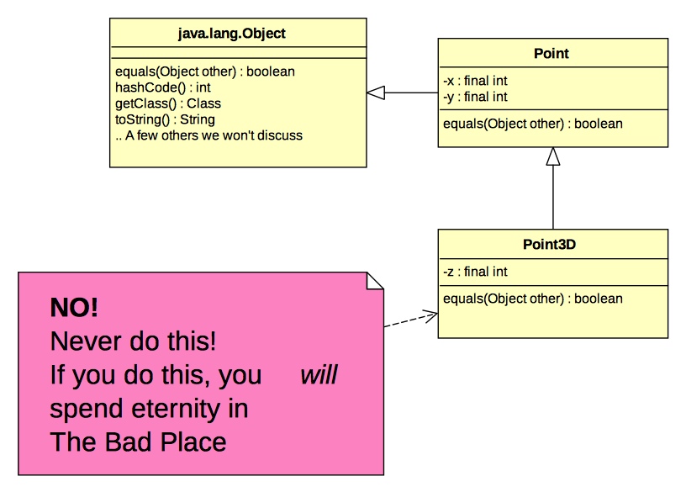


Slide 26
Also...
Using getClass() in equals() is often wrong.
In fact, in real code that doesn’t blatantly abuse the type system (like Point3D does), one would be hard pressed to argue that blindly using getClass() is even statistically more likely to be correct than blindly using instanceof.
Consider java.util.Set:
https://docs.oracle.com/javase/8/docs/api/java/util/Set.html#equals-java.lang.Object-

Slide 27
Also...
getClass() is an example of “reflection.”
Rules for using reflection:
  Don't.
  If you think it's absolutely essential, see rule 1.
  If you made it here, OK, maybe. But think very, very carefully about why you think you need it, use as little of it as possible, and try to find a better way.
  Please reconsider your use of reflection. See rule 1.

Slide 28
Guidelines for a hashtable key...
Must correctly implement equals() and hashCode()
Class should be final (no subclasses/subtypes)
  unless it has been carefully designed, like java.util.Set
Values in key objects should never change
  Often best done with an immutable object
    e.g. final fields, no public mutator methods, etc.

Slide 29

Note about reflection and Assignment 4
Java has a feature called Generic Programming
  We cover it in week 8
One of the reasons this was added to Java was to avoid needing to use reflection in certain cases
One of these cases is the kind of code that you inherited in one or more methods where the “Kind” is passed as an argument.
In order to get the java.lang.Class object for a class named MyClass, this works:
Class classObject = MyClass.class;

Slide 30
sqrt() gone bad!
4/Sqrt.java

Slide 31
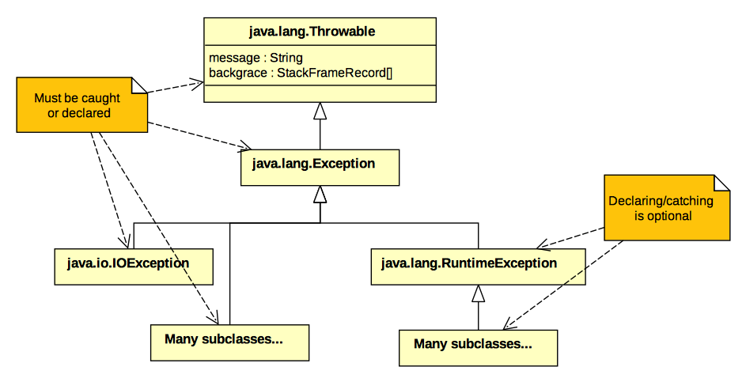

Slide 32
FileIO
MWF start here 5/4
5/FileIO.java

Slide 33
Exceptions
try / catch / finally
RuntimeException vs. Exception subclasses
  RuntimeException doesn’t need to be caught

Slide 34
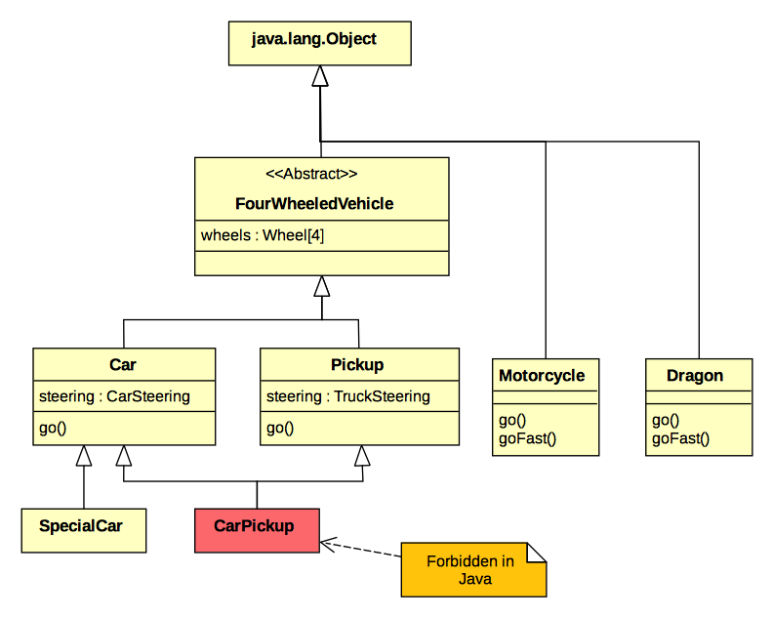

Slide 35
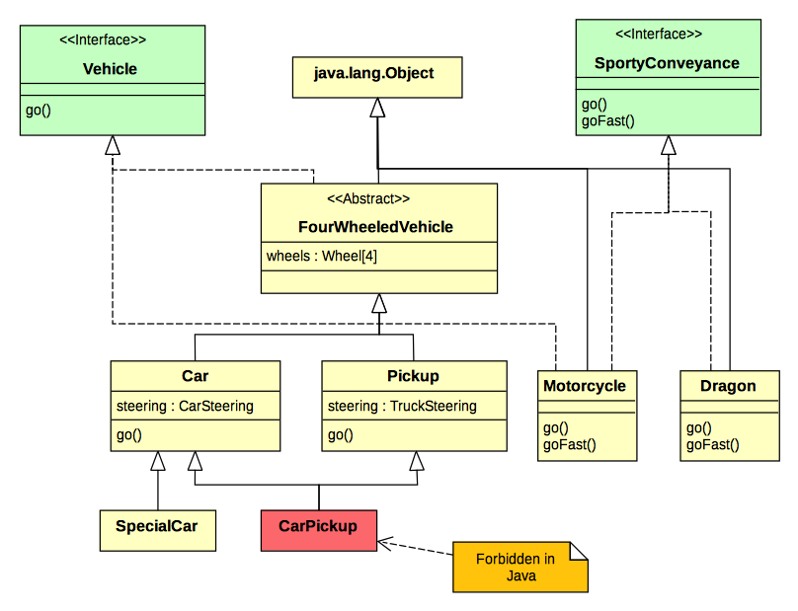

Slide 36
Review

